Slide 1
Financial Foundations
For Thriving Communities
Beyond the Bottom Line

Slide 2
Plan For our Presentation
Why GFOA is concerned about this
What we are doing about it
  Fiscal First Aid
  Financial Foundations for Thriving Communities
How we are extending these initiatives
Help we could use

Slide 3

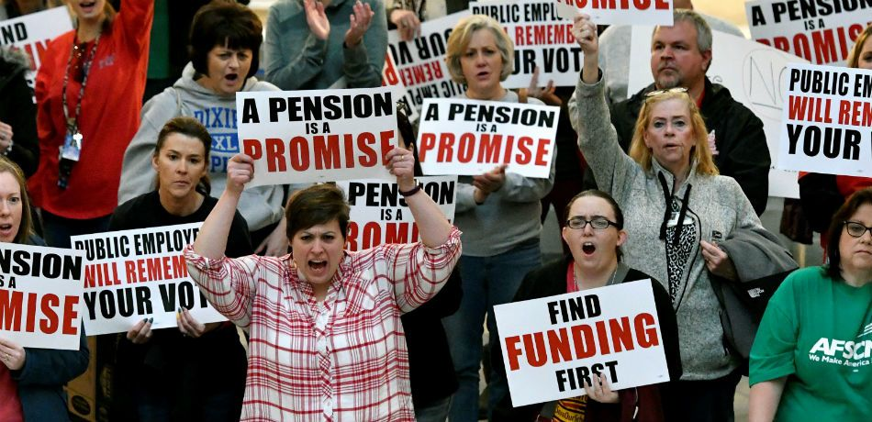
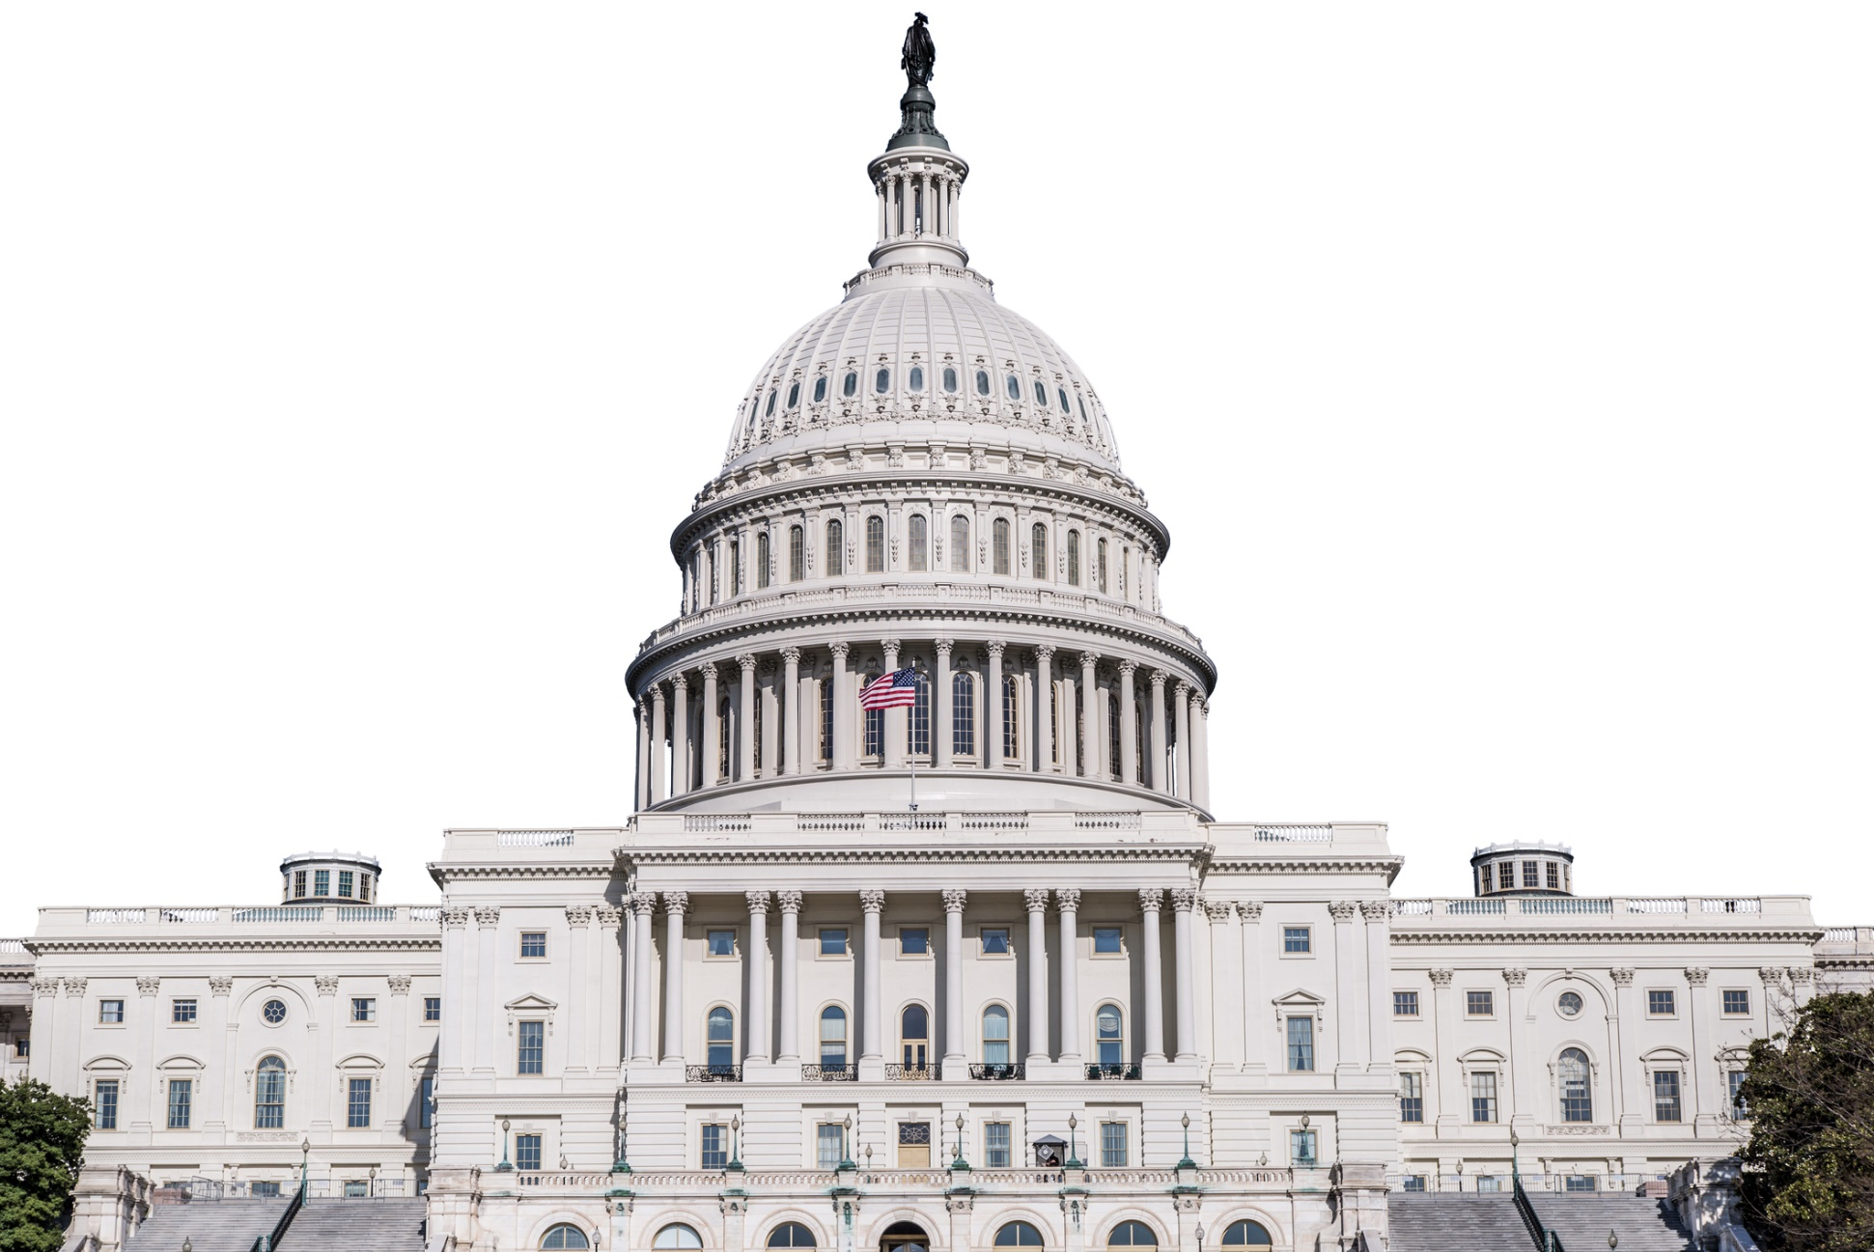
Just a Few of our long-term Challenges…
Aging Infrastructure
Pensions
Intergovernmental Uncertainty

Slide 4
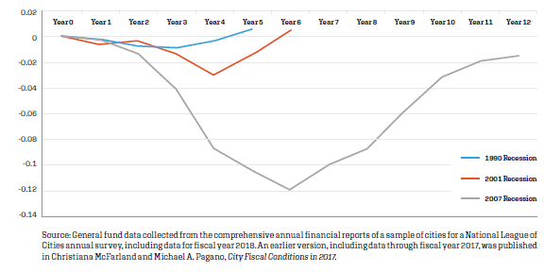
And now CoVId…
Rebound Time for Cities’ General Funds, prior recessions
From “Uncertainty, Risks and Budgets in the Age of Coronavirus” by Michael Pagano and Christiana McFarland in Government Finance Review
Notes:
Year 12 of the recovery (FY2018) indicates that cities’ general funds have just about returned to the pre-recession level. (Exhibit 2).

Slide 5
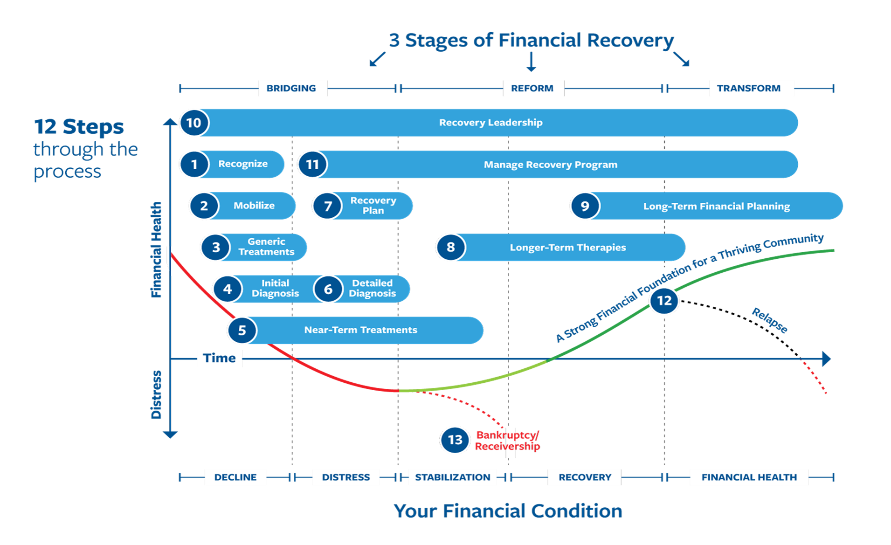

Slide 6

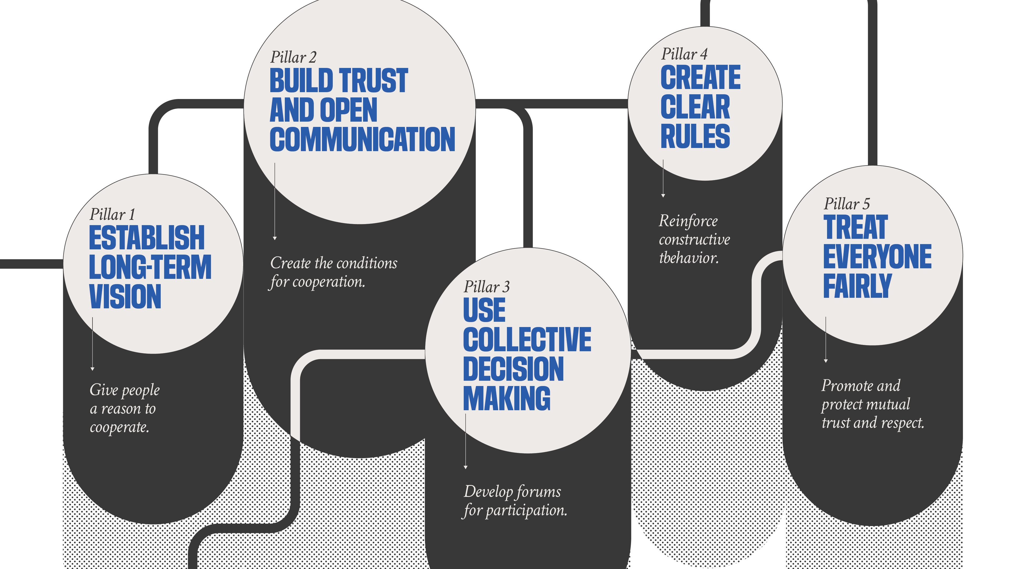
Financial
Foundations
Framework

Slide 7
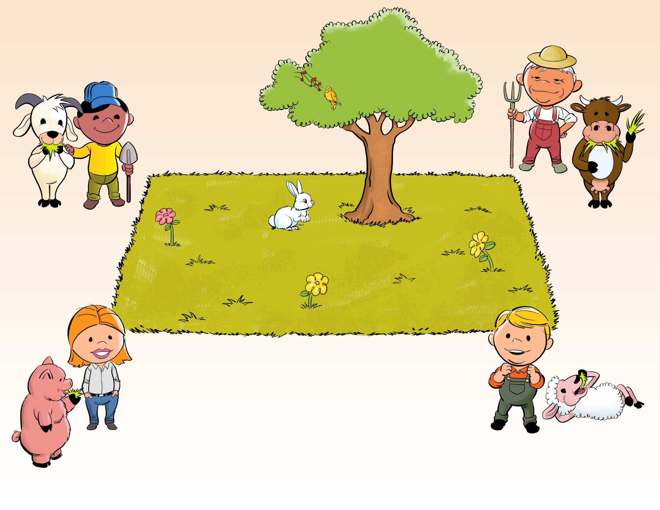
The Tragedy of the Commons

Slide 8
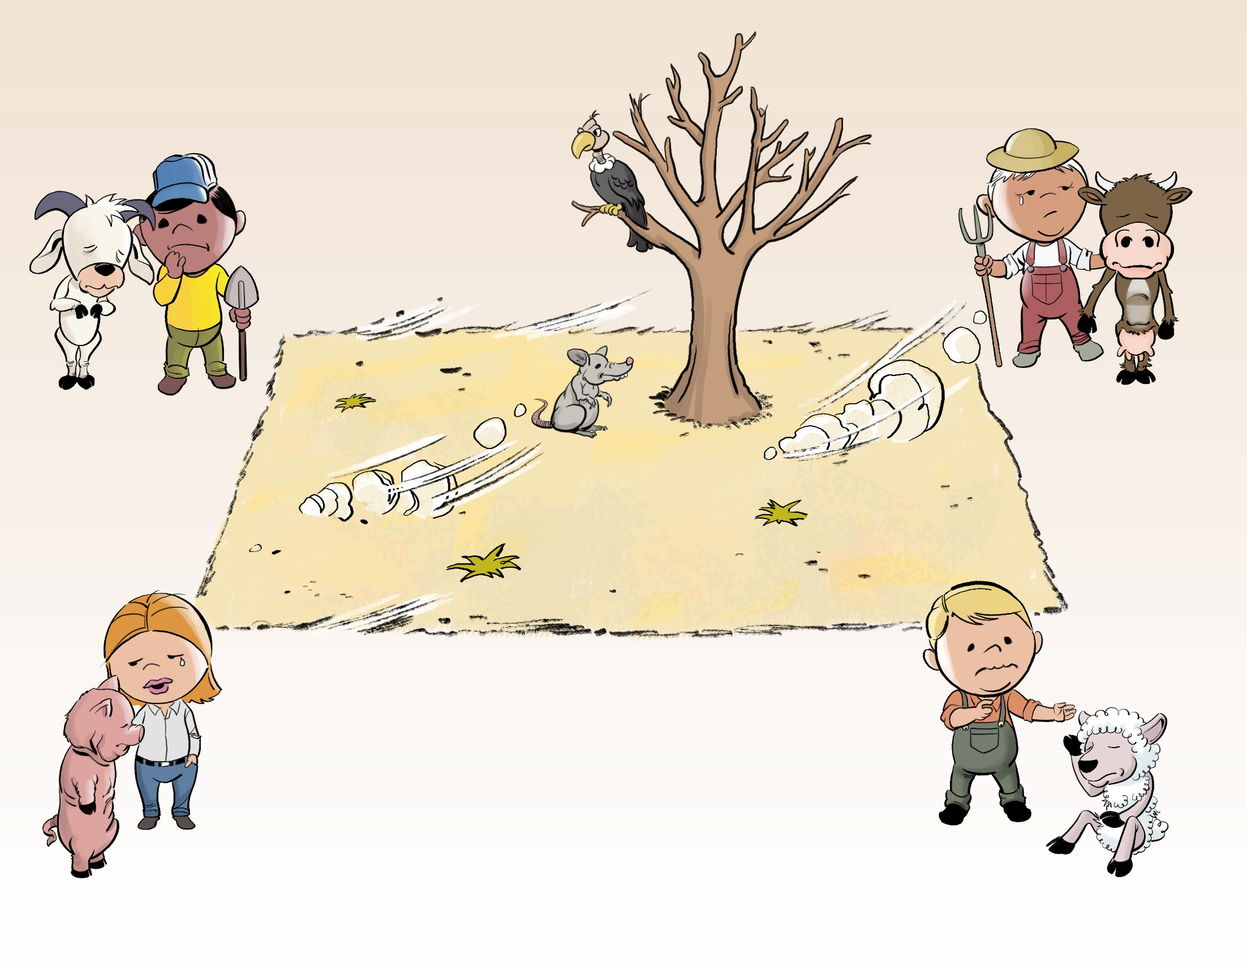
The Tragedy of the Commons

Slide 9
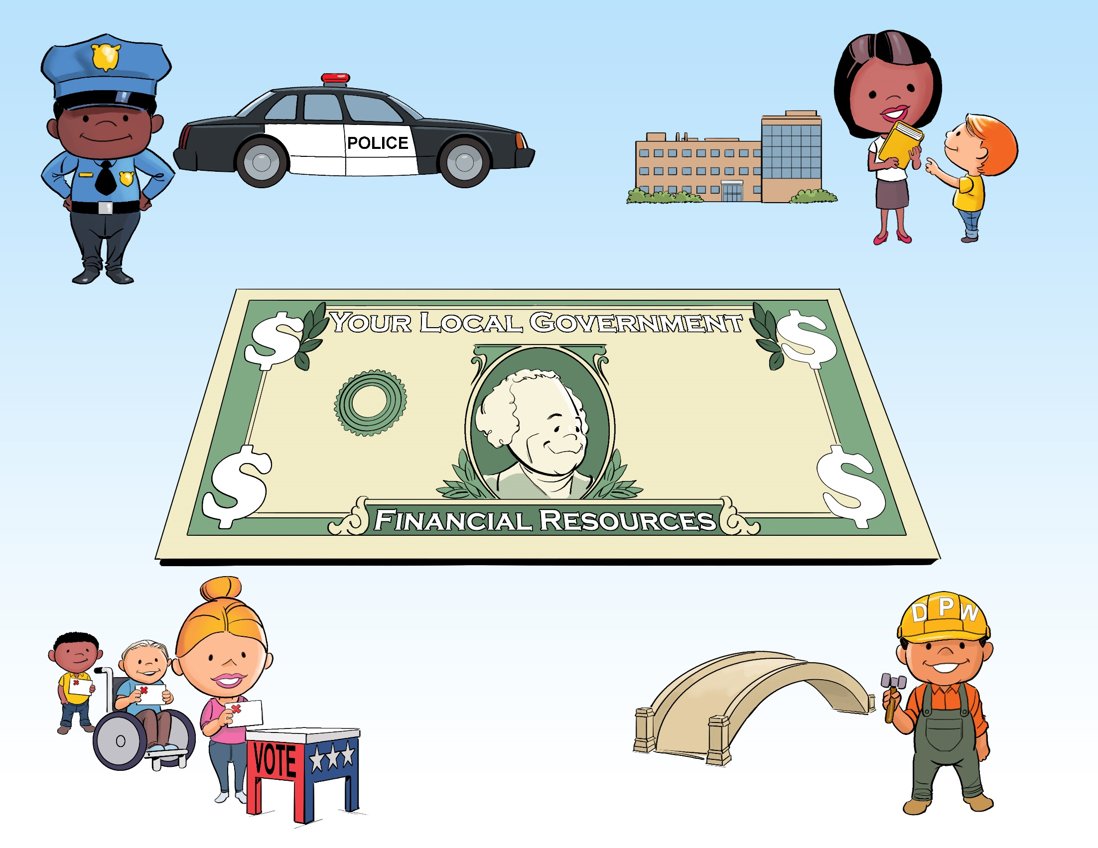
The Tragedy of Local Government?

Slide 10
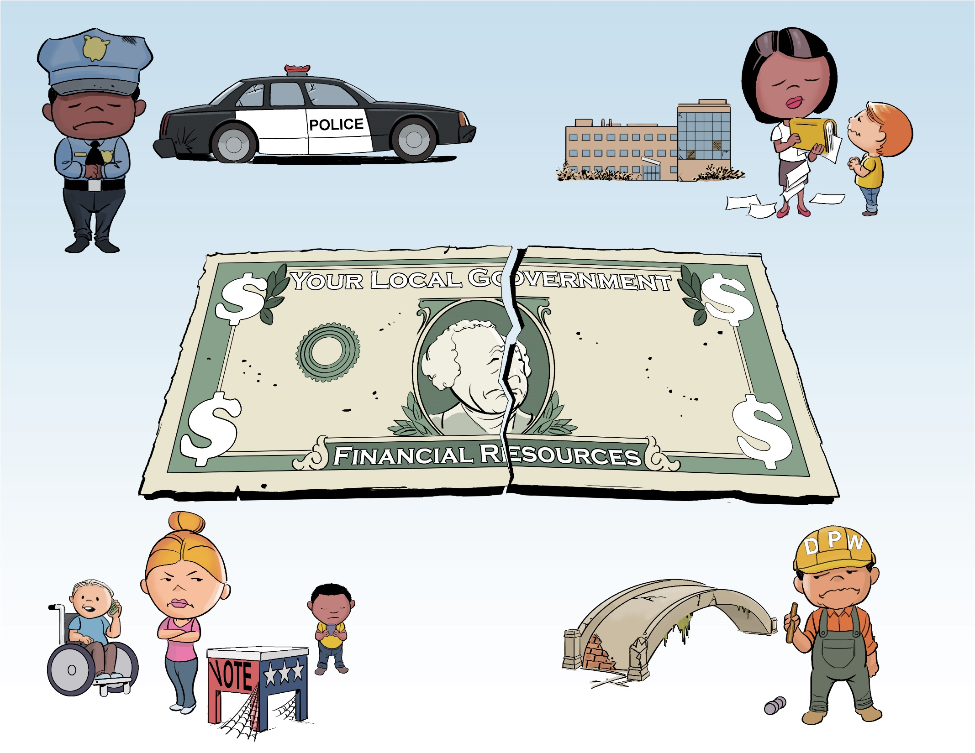

Slide 11
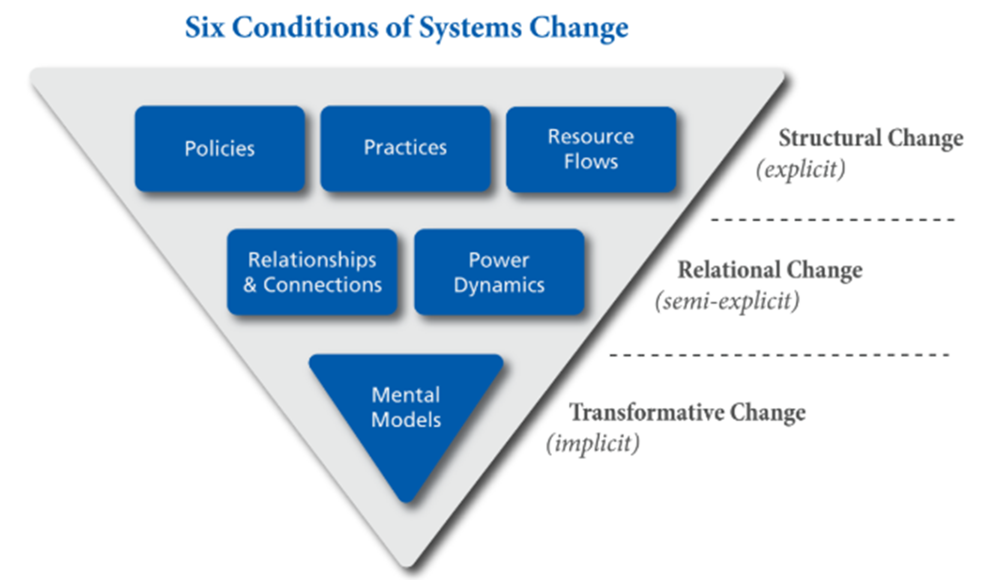
How Financial Foundations Addresses 3 Levels of Systems Change
Financial Foundations Impact
Emphasize particularly important policies, practices, resource allocation practices practitioners should adopt
--------------------------
The five “pillars” financial foundations cover these topics comprehensively
--------------------------
Financial Foundations is based on solving “the tragedy of the commons”. The commons is a powerful mental model for thinking about local govt resources
*Six conditions model from FSG.org.

Slide 12
What’s Next?

Slide 13


Credentialing system for local government “foundation builders”
Emphasize hands-on doing to build a strong foundation
Link individual work to advancing the profession and helping all communities
Members complete practical “challenges” to gain credentialing
Higher purpose than just individual accolades

Slide 14


Credentialing system for local government “foundation builders”
Intended Outcome:
Public finance officers have skills and will to build strong financial foundation in their community.
Measurable increase in uptake of key practices.
Timeline:
The 2020 Financial Policies Challenge is happening right now to pilot test credentialing. We will learn, pivot, and move forward from there.
Notes:
Can NAPA help us popularize this credential to make it a necessary thing for people to have?

Slide 15


Peer-to-peer knowledge sharing network
Accelerate re-use and dissemination of field-tested practices
Build connections between practitioners doing the work of financial foundations
Surface and publicize best work being done
Create network of supporters

Slide 16

Peer-to-peer knowledge sharing network
Intended Outcome:
Content and experience for building a strong financial foundation is readily sharable between governments.
Measurable progress in both quality and quantity of resource shared.
Timeline:
The 2020 Financial Policies Challenge is also pilot testing elements of peer-to-peer knowledge sharing. Again, we will learn, pivot, go forward form there.

Slide 17


Learning conference
Personal touch
Focused on interests of people engaged in building a strong financial foundation
Nothing beats in-person network and learning together
Can be more focused than a more generalist forum

Slide 18

Learning Conference
Intended Outcome:
People make connections with likeminded folks and workshop solutions to common problems.
Tangible, actionable solutions created at conference.
Timeline:
GFOA was working with a likeminded organization, ResourceX, to pilot test a Financial Foundations conference in August 2020. Now exploring virtual option

Slide 19
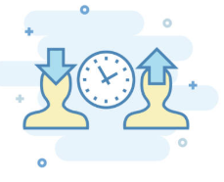

E-Learning
On-demand
Nano-learning opportunities
Asynchronous education to fit busy schedules.
Fit time available and may also match how adults learn best

Slide 20
E-learning
Intended Outcome:
Public finance officers learn concepts and practices needed to support a strong financial foundation.
Timeline:
GFOA has built its first course “Giving Voice to Values”. This is a partnership with the inventor of this curriculum, who has a proven track record in e-Learning. Available now. GFOA has procured LMS.
Also piloted nano-credits as mini-podcasts

Slide 21


influence strategy
This is what gets GFOA members’ attention
Stock-and-flow diagram describes stocks (in black), which are capacities and forces that change capacities (in blue). This can highlight leverage points for system change
Lack of time is, by far, the biggest barrier to doing new things
Explaining ideas to elected officials, other staff is big part of what many members do

Slide 22
Conversation about Where to Next

