Slide 1
Human Capital Management System (HCMS) Overview – June 2018

Slide 2
HCMS Business Case:
Current Situation:
  Manual processes caused for redundancy and duplication
Pain-points
  Hiring activities take up to 20% of managers time
  Managers do not understand what needs to be done
  Managers end up with the wrong candidates
HCMS Objectives:
  Streamline & simplify the hiring process
    Streamline business processes, removing those that are no longer relevant
  Lessen the administrative burden on managers
  Free up ~17 staff years, allowing redirection of productivity to mission-related work
2
2

Slide 3
HCMS: Module Definition
PD Express (PDX) is an automated, web-based tool that managers can use to create and store position descriptions.
Job Announcement Express (JAX) is an automated, web-based tool that managers can use to create and store job announcement components (such as Job Analyses, Job Questionnaires and Category Ratings).
Workforce Planning Dashboards provide managers with instant access to their workforce demographics, projected retirements, and workforce changes in their organization.
Organization Chart Express (OCX) is an automated, web-based tool that was developed for the Service’s managers to automate and streamline the process of developing and maintaining Organization Charts.

Slide 4
HCMS Modules
Module
Goals
PD Express (Avail: 08/2011)
Job Announcement Express (Avail: 12/2013)
Workforce Planning Dashboard (Prototype using in-house tools: 08/2014)
Organization Chart Express (Avail: 03/2016)
Performance Appraisal Tool (Future Scope)
115 days to 10 days
60 days to 10 days
Real time information to Managers
Automate chart creation & create position hierarchy
Fix broken Performance Appraisal process

Slide 5
HCMS: What You Can Expect
Technology Improvements
  Reduction in rework and increase in readily-available product samples
  Visibility & integration with down-stream, next steps in hiring process
  Opportunity to better leverage existing information
Process Improvements
  Reduction in loss of “best resources” due to duration of hiring process
  Culture changes in the hiring process
    Creation of business rules and enforcement of time limits
    Better control over the product being delivered
5
5
5
Notes:
5

Slide 6
HCMS: Workforce Planning Dashboard
6
6
Simplifies the process of providing key metrics of present, past and future workforce add value to managers and HR
Easy access to Workforce Profile data to answer quick, high level questions
Historical attrition and retirement eligibility data provides insight to the future
Inventoried competencies highlight future vulnerabilities
Hierarchical functionality gives managers and executives visibility into workforce and in-progress hiring actions
Notes:
Provides a high level look at the profile of a managers’ workforce – including some “standard” metrics that are required for a DOI workforce plan - to provide:
A quick look of what a manager has and how vulnerable their workforce is to retirement (i.e. retirement eligibility or years of service))
Some quick answers to questions that too commonly come to HR (counts of employees, students, workschedule questions for telework, diversity, etc.)
Past metrics: Attrition: Separations and Retirements to see trends in turnover, esp. for positions classified as Mission Critical (MCO)
Future: Competencies: Know what you have, with respect to what you need and what you’re vulnerable of losing, so that you can prepare accordingly
* We piloted a Competency Based Workforce Planning with 3 orgs in our Ches Bay region:
- Asked managers what science competencies they “need”
- Asked employees – via survey – what science competencies they had (and at what proficiency level, etc.)
What we get: A matrix of needs vs what we have, which we can marry with workforce personnel data to prepare for retirements, train for the future, hire and recruit for future needs, not just to replace what we had.
Hierarchical display and functionality: Managers may “know (their) people”, but that next level up…or that organization next door might not…this gives insight to profile data, competency data and vulnerabilities, and in-process hiring actions

Slide 7
HCMS: Organization Chart Express
Automates and standardizes the development of organizational charts and maintains an up to date record of all organizational charts across the Service.
Fast and accurate creation and updating of Organization Charts using FPPS data and process standardization
Repository of signed approved organizational charts for all FWS Org Codes
Easy access to Organization Charts and information to support yearly submission requirement
Accurate information for forecasting multiple scenarios such as; budget planning, decision-making for hiring actions, physical moves, & office space planning
Provides access to Executive level Organization Charts
Supports disaster recovery though easily accessible reporting system that provides current list of FWS employees and contact information

Slide 8
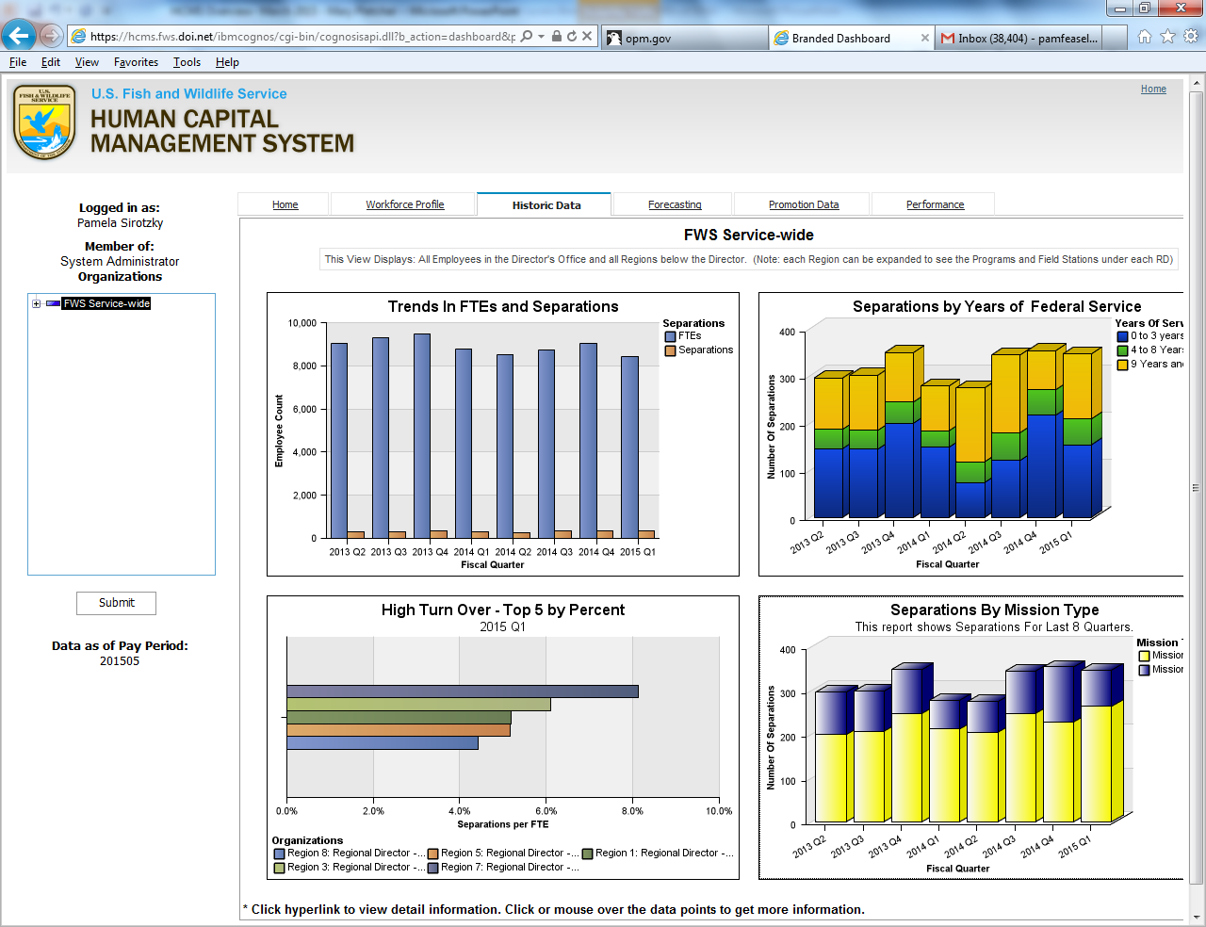
WFP Dashboard: Historic Data Screen

Slide 9
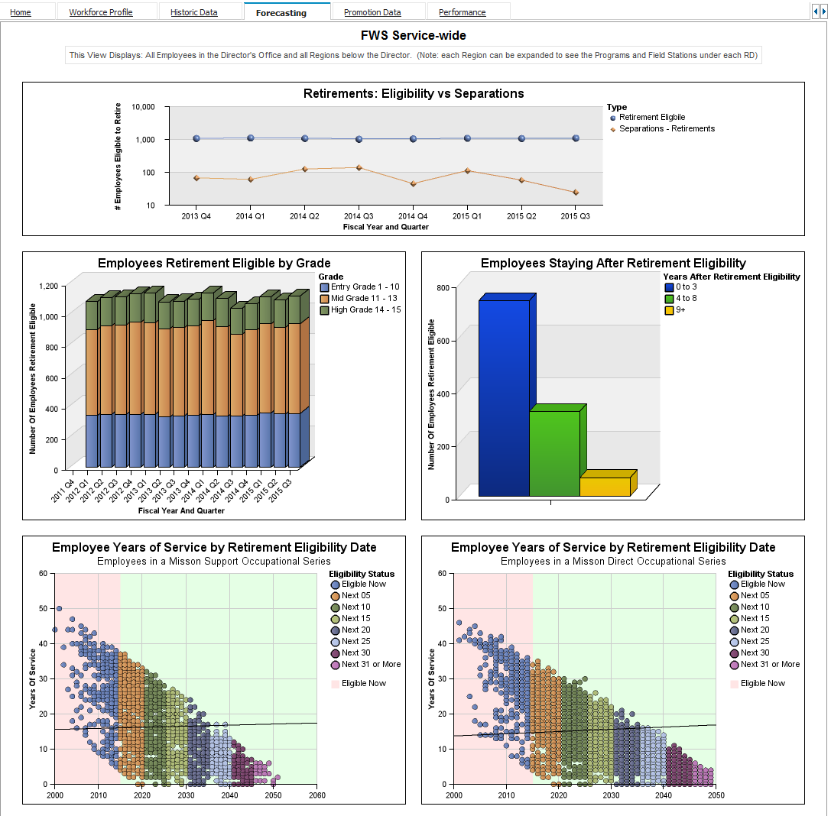
WFP Dashboard: Forecasting Screen

Slide 10
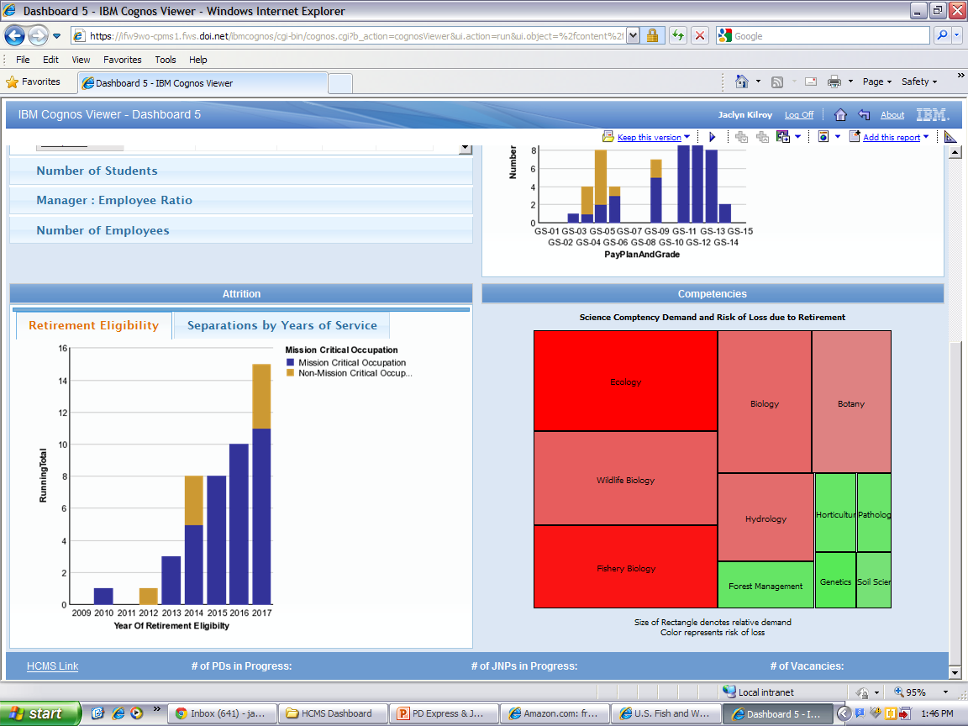
Workforce Planning & Competency Mgmt
Pilot at Chesapeake Bay
Managers identified demand for science competencies and SHC work processes
Employees surveyed
FPPS data used to show vulnerabilities of competencies/work processes lost due to retirement eligibilities
10
10
Notes:
In the Pilot, and the GOAL for the future:

Slide 11
Next Steps
11
11
Single Portal Page that provides Organizations access to:
  PD Express
  Job Announcement Express
  Workforce Planning Dashboard
  Organization Chart Express
  Performance Management
  Competency Management
Notes:
Provides a high level look at the profile of a managers’ workforce – including some “standard” metrics that are required for a DOI workforce plan - to provide:
A quick look of what a manager has and how vulnerable their workforce is to retirement (i.e. retirement eligibility or years of service))
Some quick answers to questions that too commonly come to HR (counts of employees, students, workschedule questions for telework, diversity, etc.)
Past metrics: Attrition: Separations and Retirements to see trends in turnover, esp. for positions classified as Mission Critical (MCO)
Future: Competencies: Know what you have, with respect to what you need and what you’re vulnerable of losing, so that you can prepare accordingly
* We piloted a Competency Based Workforce Planning with 3 orgs in our Ches Bay region:
- Asked managers what science competencies they “need”
- Asked employees – via survey – what science competencies they had (and at what proficiency level, etc.)
What we get: A matrix of needs vs what we have, which we can marry with workforce personnel data to prepare for retirements, train for the future, hire and recruit for future needs, not just to replace what we had.
Hierarchical display and functionality: Managers may “know (their) people”, but that next level up…or that organization next door might not…this gives insight to profile data, competency data and vulnerabilities, and in-process hiring actions

Slide 12
Thank You!

