Slide 1
Fiscal Condition of the States
June 29, 2020
Shelby Kerns
Executive Director
skerns@nasbo.org

Slide 2
Revenue Sources in the General Fund
Percentage
Estimated Fiscal 2019
Source: NASBO State Expenditure Report

Slide 3
General Funds Expenditures
By Function
Estimated Fiscal 2019
Source: NASBO State Expenditure Report

Slide 4
Total State Expenditures
By Fund Source
FY19
$2,119 Billion
Source: NASBO State Expenditure Report

Slide 5
Total State Expenditures
By Function
Estimated Fiscal 2019
Source: NASBO State Expenditure Report

Slide 6
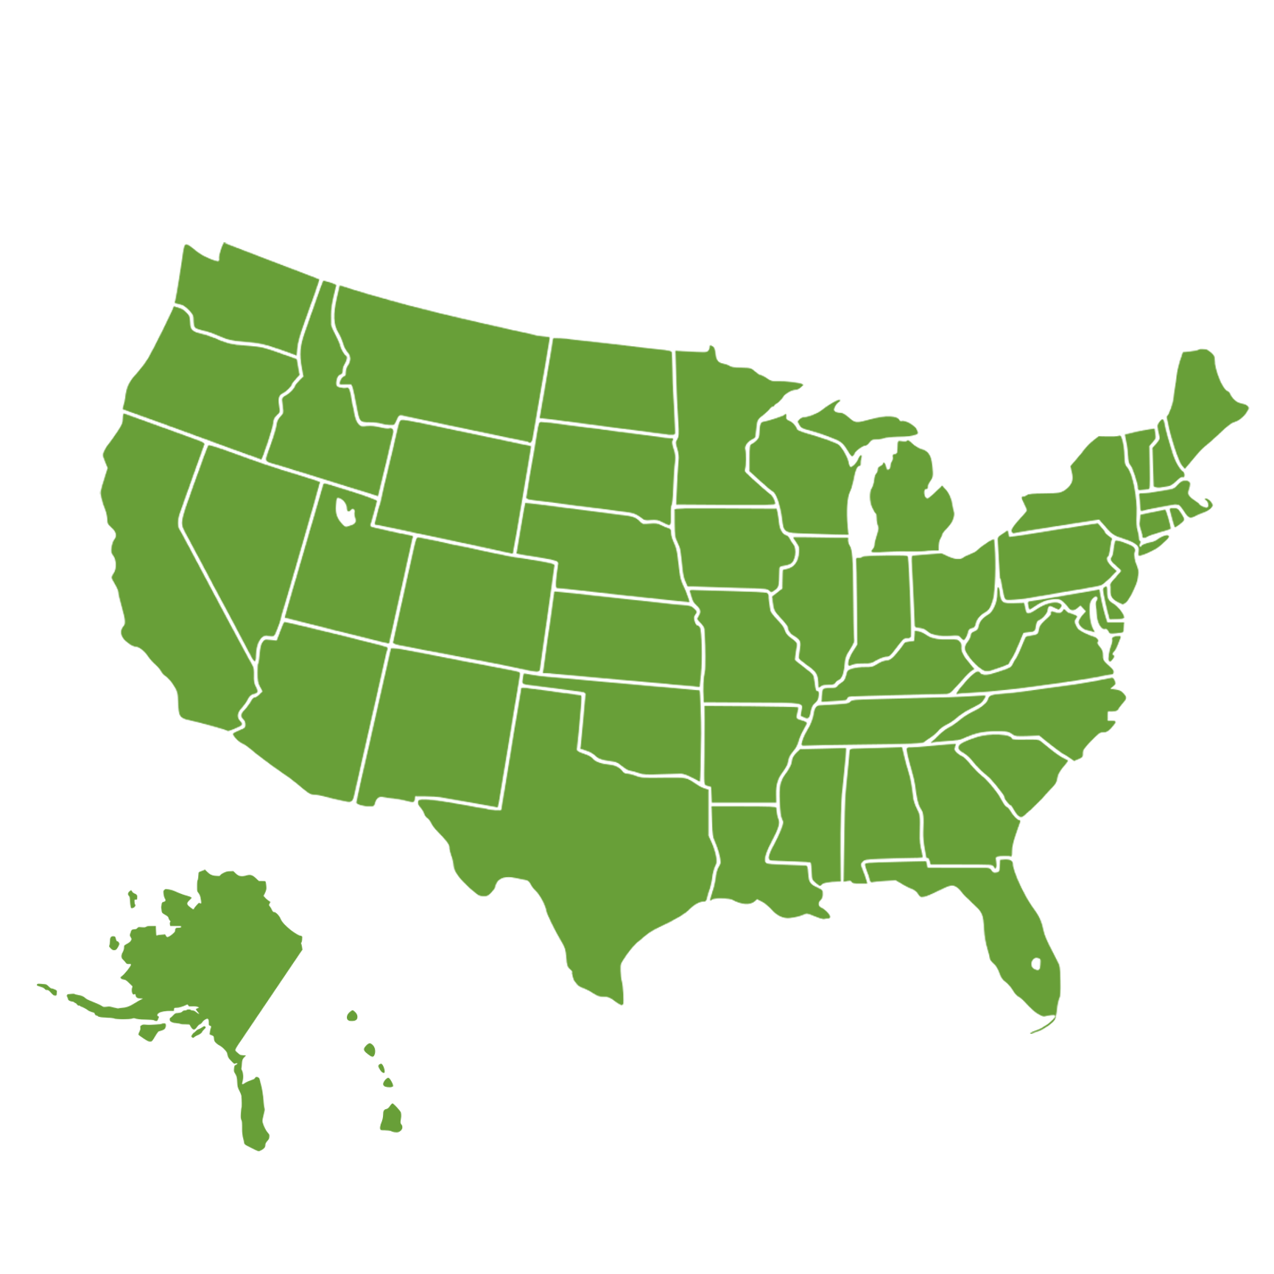
Finished FY 2019 with revenue surpluses
Rainy day funds at highest levels
Cautionary tale: preparing for the next downturn
Long term challenges: pensions and retiree health liabilities; infrastructure and transportation demands
FY 2020 budgets include another year of modest spending growth
K-12 and Higher Ed – usually big gainers in good times
What was the state fiscal environment for 2020 legislative sessions?
(FEBRUARY 2020)
6

Slide 7
46 States Had Fiscal 2019 Revenue Collections Exceed Budget Projections
Source: Fall 2019 Fiscal Survey of States

Slide 8
Most States Continued to Strengthen Rainy Day Funds Median balance reached all-time high 41 States Reported Increases in Fiscal 2019; 32 States Were Forecasting Increases in Fiscal 2020
Source: Fall 2019 Fiscal Survey of States

Slide 9
State General Fund Spending Was Expected to See Moderate Increase In Fiscal 2020, Following Above-Average Growth in Fiscal 2019 45 States Enacted Spending Increases in Fiscal 2020
*Average
41-year historical average annual nominal growth rate in state general fund spending is 5.4 percent.
Source: Fall 2019 Fiscal Survey of States

Slide 10
No States Made Mid-Year Budget Reductions in Fiscal 2019 Due to a Shortfall
Budget Cuts Made After The Budget Passed
Recession ends
Recession ends
Recession ends
Note: Beginning in Fiscal 2018, NASBO asked states reporting net mid-year budget reductions as to whether the reductions were made due, at least in part, to a revenue shortfall. Effective in FY2018 going forward, only states reporting mid-year budget cuts due to a shortfall are included in the totals reported in this figure. Prior to FY2018, particularly in non-recessionary periods, states that reported mid-year cuts that were due to other reasons, such as a reduction in caseload, would have been included in the counts above.
10
Notes:
No states reported making mid-year budget cuts due to a revenue shortfall in FY 2019, with just 3 states approving modest net reductions for other reasons #fiscalsurvey bit.ly/2gF7ael

Slide 11
Key Themes & Common Budget Items for Fiscal 2020 (FEBRUARY 2020)
Teacher pay increases
Early Education – Pre-K expansions
More states starting and expanding last dollar two-year college degrees
Medicaid expansion and some supplemental funds for FY 2019
Corrections employees – additional hiring and increased pay
Children’s service/child welfare
Housing
Workforce Development
Broadband/wireless expansion
Full funding of pension contributions plus some extra for unfunded liabilities
State employee pay increases – many budgets have 2 to 3%. Most number states in many years
One-time spending from one-time funds – many different initiatives

Slide 12
State Budgets Provide Significant New Resources for Education & Other Key Priorities Enacted General Fund Budgets for Fiscal 2020 Provide for Net Appropriation Increases of $39.1 Billion
Net increases for fiscal 2020 are compared to enacted appropriation levels for fiscal 2019. Net increases for fiscal 2019 are compared to enacted levels for fiscal 2018.

Slide 13
All sources of revenue being impacted by COVID-19
Impacting states in different ways and different magnitude
States have begun revising revenue forecasts
States are beginning to estimate the size of budget gaps
Different than other recessions – public health emergency and sharp economic declines
States are facing both increased spending demands and significant revenue declines
Personal income, sales, corporate income, motor fuel, gaming
E.g. oil producing states; tourism; manufacturing
What is the current fiscal environment for states?
(JUNE 2020)
13

Slide 14
Ways to address budget shortfalls
Budget cuts
Can include targeted cuts, across the board, personnel, etc.
Rainy day funds and reserves
Size of shortfalls greater than amount in rainy day funds
Try not to drain immediately
Increased taxes
Typically not first option and amount less than budget cuts
Federal aid
Was very helpful during Great Recession
This time: question of how flexible and how much

Slide 15
Revenue declines during Great Recession (From fiscal 2008 to fiscal 2010)
Total general fund revenue: -11.6%
Sales tax: -6.8%
Personal income tax: - 14.7%
Corporate income tax: - 24.1%
Gaming: -7.8%
All other revenue: -8.2%

Slide 16
General fund expenditure declines during the Great Recession (From fiscal 2008 to fiscal 2010)
Total general fund expenditures: -9.2%
Elementary and secondary education: -7.9%
Higher education: -10.5%
Public assistance: -5.5%
Medicaid: -16.2%
Corrections: -3.9%
Transportation: -15.5%
All other: -7.6%

Slide 17
Midyear program cuts by budget area – Fiscal 2010
Elementary and secondary education: 35 states
Higher education: 37 states
Public assistance: 22 states
Medicaid: 31 states
Corrections: 37 states
Transportation: 21 states
All other: 38 states

Slide 18
Strategies Used to Manage Budgets, Fiscal 2010
35 states
TARGETED CUTS
25 states
ACROSS THE BOARD CUTS
24 states
LAYOFFS
16 states
FURLOUGHS
9 states
SALARY REDUCTIONS
13 states
CUTS TO STATE EMPLOYEE BENEFITS
19 states
REDUCE LOCAL AID
14 states
REORGANIZE AGENCIES
13 states
RAINY DAY FUND
19 states
USER FEES

Slide 19
States will continue to respond to increased spending demands from the coronavirus
Will take actions to ensure fiscal 2020 budgets are balanced
Question of how much federal aid and how flexible
States will likely face impact of COVID-19 for many years to come
Adjusting revenue forecasts for fiscal 2021
Fiscal 2021 budgets will continue to be revised, including after enactment
Outlook for states FY 2020 and beyond
19

Slide 20
www.nasbo.org
Shelby Kerns
Executive Director
National Association of State Budget Officers | NASBO

