Slide 1
Intergovernmental Stresses
Highlights and Lowlights of the Pandemic Response
Elizabeth Kellar, June 29, 2020

Slide 2
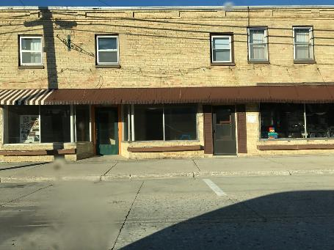
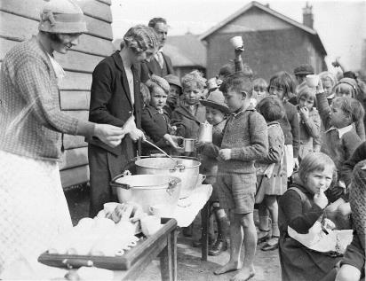
The COVID-19 Recession: Swift, Severe Impact
During the Great Recession, state and local governments lost 720,000 jobs over several years. In April and May 2020, they shed 1,468,000 jobs.
The International Monetary Fund predicts the current downturn will be the worst since the Great Depression in the 1930s.
Notes:
Recovery could take years as we won’t approach resumption of normal activity until a vaccine is developed. 85% of state/local job losses are in local government, with education jobs most affected.

Slide 3
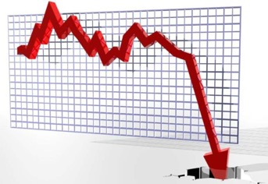
CARES Act
$150 billion for state and local governments
For COVID-19 expenses only; not for revenue shortfalls
Treasury guidance has lagged
Direct aid only to cities and counties above 500,000 population
Some states developed a plan to distribute to smaller hard-hit local governments
Documentation worries
Notes:
FAQs come out, but not the kind of specific guidance local governments need to be sure that their expense reimbursement requests won’t e rejected.

Slide 4
Revenue Losses
Sharp declines in personal income and sales taxes
Fees are down (including those designated for bonds)
Property taxes are the most stable for now
Overall, most states and local governments face a 10-20% decline in revenues
Notes:
Total state and local income and sales tax revenues were over $1 trillion going into this downturn.

Slide 5
Cities and Counties
$360 billion revenue loss for cities projected over the next 3 years; 74% of municipalities have already started making cuts (June 2020 NLC Survey of 1100 municipalities)
Counties anticipate $114 billion in lost revenue from county-collected sales tax and local fees and an additional $30 billion in COVID-19 response costs.

Slide 6
Need for Fiscal Federalism
FMAP percentage was more generous in Great Recession - 12% federal share v. 6.2% temporary federal share today
Match still required for FEMA disaster assistance and other grants; Treasury issued an FAQ on 6/24 saying CARES funds can be used for FEMA match
Mandate for states/locals to provide additional paid leave (Families First Act), but cannot claim tax credit like private sector
Reimbursement for state and local revenue losses
Notes:
Federal Medical Assistance Percentage. We face a similar health care crisis today as workers not only are losing their jobs, they also are losing their health insurance coverage. These individuals turn to Medicaid or purchase health insurance plans through the Affordable Care Act’s marketplace. In March, the federal government increased its share of the costs for Medicaid to 6.2 percent in the Families First Act, roughly half of what the federal government provided in the 2009 Recovery Act. State and local governments are asking for a temporary increase in the Federal Medicaid Assistance Percentage (FMAP) from 6.2 percent to 12%
In an operational win this week, however, states and localities got the news they’d been waiting for - the Department of the Treasury officially updated its CARES Act guidance to state that, “Payments from the Fund may be used to meet the non-federal matching requirements for Stafford Act assistance to the extent such matching requirements entail COVID-19-related costs that otherwise satisfy the Fund’s eligibility criteria and the Stafford Act.”
The Frequently Asked Questions document also noted that SLTT governments may presume that payroll costs for public health and safety employees are payments for services substantially dedicated to mitigating or responding to the COVID-19 public health emergency, making them eligible for Coronavirus Relief Fund spending.

Slide 7
Local Agency Revenue Impacts Vary by Source
Property Tax
Income Tax
Sales Tax, Hotel Tax, Property Transfer Tax
Business License Tax
Utility Users Tax, Franchise Payments
Recreation and Fee Programs

Slide 8
Intergovernmental Challenges
Big 7 and national association coordination
Direct, robust, flexible aid
Issues
Purchasing is 11% of GDP; CBO found state and local purchases have declined by $350 billion, accounting for 9% of total GDP decline
More unemployed as furloughs and job cuts continue, with losses of teachers & front line responders
Reducing infrastructure investments
Reinstating advance refunding of bonds while interest rates are lower would help
Notes:
DR. AMY ACTON, OHIO'S PUBLIC HEALTH DIRECTOR, RESIGNED EARLIER THIS MONTH AFTER RECEIVING THREATS, ANTI-SEMITIC SLURS AND BEING CALLED A “MEDICAL DICTATOR.”
Even outside of emergency services and law enforcement, the pandemic is stressing out local government employees. Many are forced to work at home, where they may have a house full of kids (and perhaps a spouse).

Slide 9
Front Line Stresses
Some states have allowed local governments to impose more public health restrictions; others have not
Conflicting messages and politicization of public health; threats of violence, anti-semitic rhetoric
Pressures to reopen; spikes causing reassessment
Protests and rallies add to the unending crisis mode
Preparing for natural disasters in a pandemic
Operating a virtual workplace, returning to work, and seeking ways to reopen front line services safely
Layoffs and furloughs
Notes:
DR. AMY ACTON, OHIO'S PUBLIC HEALTH DIRECTOR, RESIGNED EARLIER THIS MONTH AFTER RECEIVING THREATS, ANTI-SEMITIC SLURS AND BEING CALLED A “MEDICAL DICTATOR.”
Even outside of emergency services and law enforcement, the pandemic is stressing out local government employees. Many are forced to work at home, where they may have a house full of kids (and perhaps a spouse).
Ahead of hurricane season, Leon County, Fla. Emergency Management Director Kevin Peters said the county is working with the state’s division of emergency management, the FEMA regional office and the state’s emergency management association to discuss changes to shelter operations.
New measures at shelters may include entrance screening, taking temperatures, using CDC guidance for health questionnaires and creating isolation areas for those who may present COVID-19 symptoms.
When it comes to providing long-term shelters for individuals who have lost their homes, Peters said the county is holding conversations with the Red Cross to discuss shelter options in a post-storm environment while dealing with COVID-19. New criteria may include a cap on the number of people per square foot. The county is also working on plans to allocate personal protective equipment for those in shelters.
Wildfire-prone areas like Sonoma County face similar issues: The county is looking at more diverse shelter options so fewer people are housed in each location and can practice social distancing. For those who may have COVID-19-related symptoms, hotels are being considered rather than a congregate shelter.
Godley said he anticipates more individuals will need to stay at community shelters because they won’t be able to stay with friends or family, over health concerns.

Slide 10
What’s Next
ICMA planning survey on CARES Act, fiscal and other local government challenges
Virtual conferences and events
After action meeting of National Homeland Security Consortium to discuss lessons learned from initial pandemic response

